Slide 1

Unsupervised Algorithms in Machine Learning
CSCA 5632

Slide 2
Online Retail
Project Description
This dataset contains transactional data which contains all the transactions between 01/12/2010 to 09/12/2011 for a UK based and registered non-store online retail.
Main Goal of the project:
Understand Customer purchasing behaviour using RFM strategy (Recency/Frequency/Monetary)
Identify distinct customer groups using k-means clustering , HDBSCAN/DBSCAN and hierarchical clustering algorithms.
Detect Outliers (Customers with unusual purchasing patterns)
Providing actionable insights for the marketing teams.

Slide 3
Citation
Citation:
Seo, J. S. (2015). Online Retail Data Set from UCI ML repo. Kaggle.com. https://doi.org/10.1057/dbm.2012.17)
Chen, D. (2015). Online Retail [Dataset]. UCI Machine Learning Repository. https://doi.org/10.24432/C5BW33.
Source:
Dr Daqing Chen, Director: Public Analytics group. chend '@' lsbu.ac.uk, School of Engineering, London South Bank University, London SE1 0AA, UK

Slide 4
Project Steps
Topics we’ll Be Covering in this project
Data Loading and Inspection
Data Cleaning and Preprocessing
EDA
Feature Engineering
Feature Scaling
Unsupervised Learning
Dimensionality Reduction
Clustering Algorithms
Market Basket Analysis
Conclusion
Things to Improve
References

Slide 5
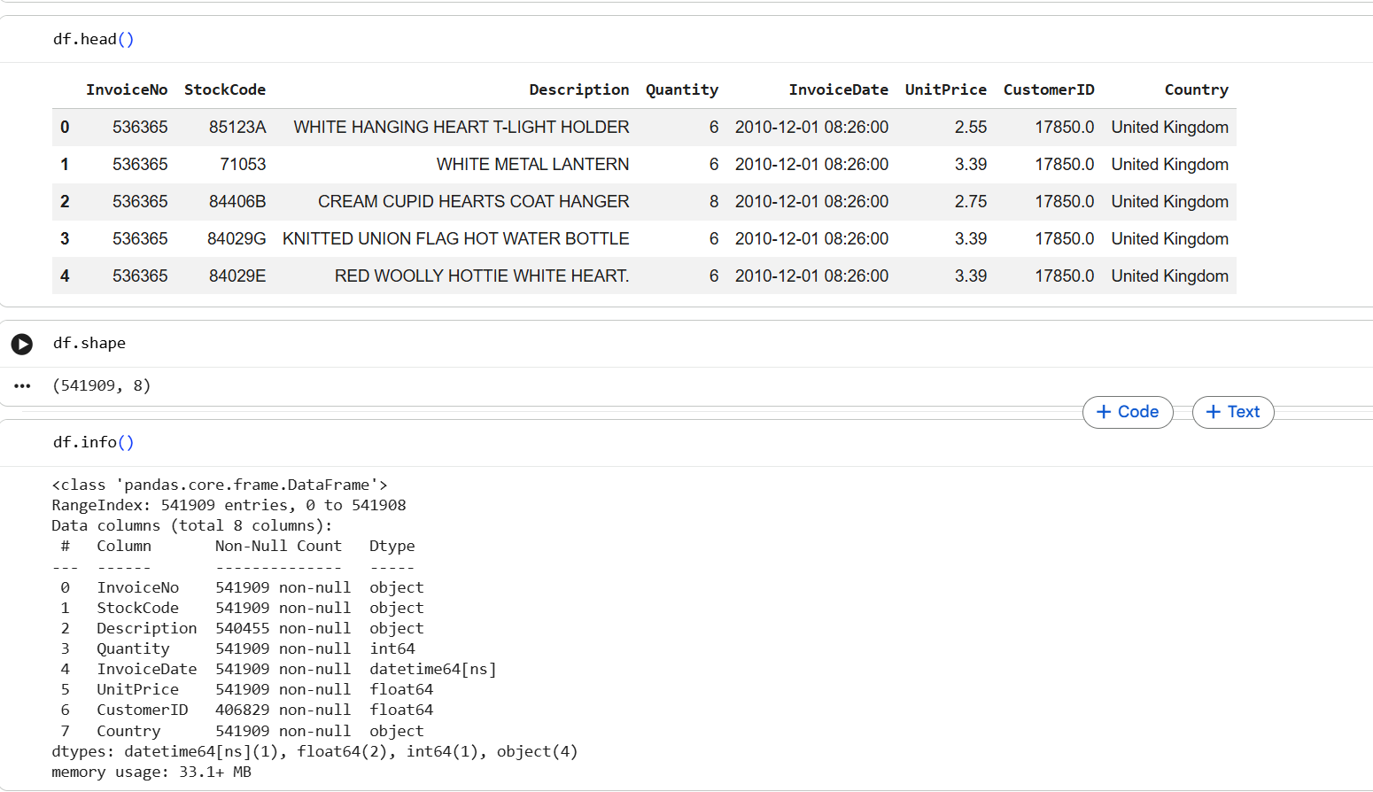
Data Loading and Inspection

Slide 6
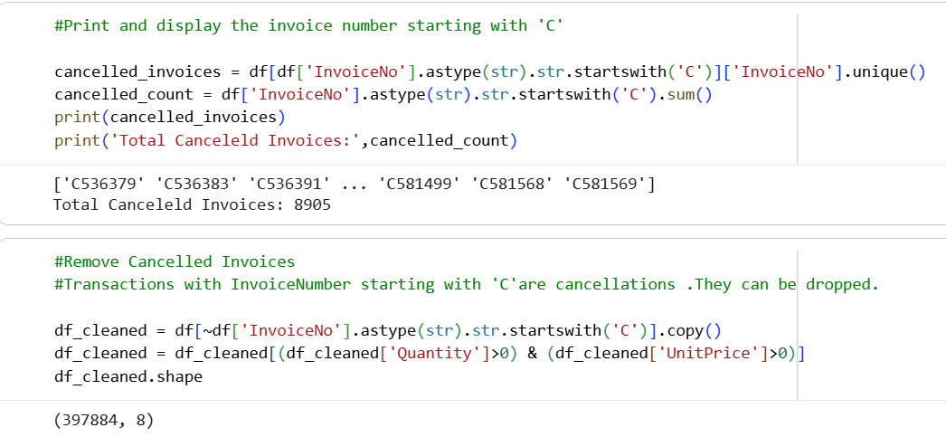
Data Cleaning and Preprocessing
Preprocessing Stage 1
Handle Missing values
Check for data types
Cancelled invoices should be removed
Check for outliers

Slide 7
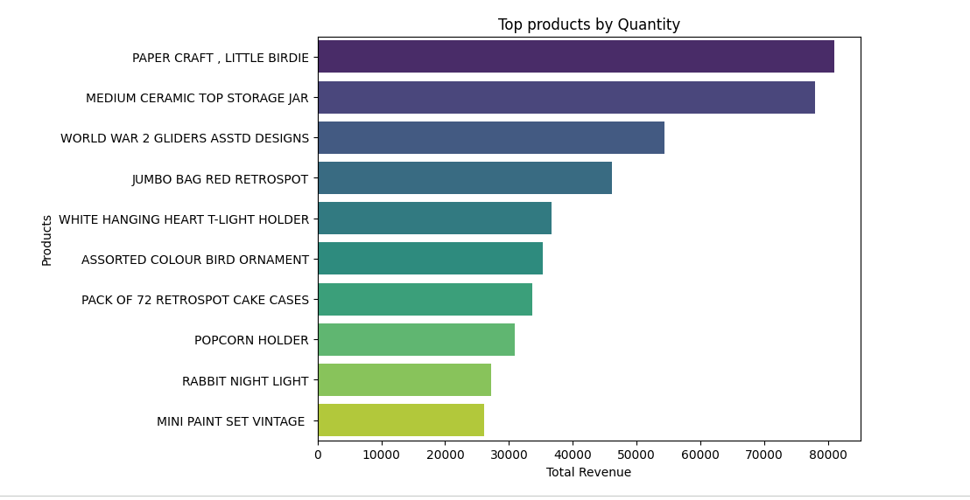
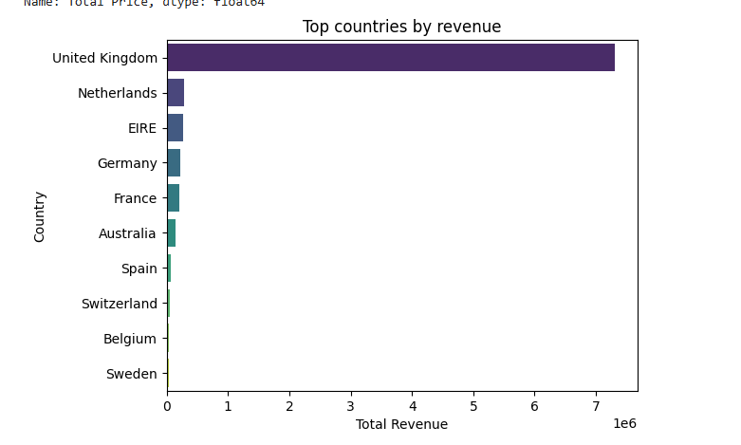
Exploratory Data Analysis
Top 10

Slide 8
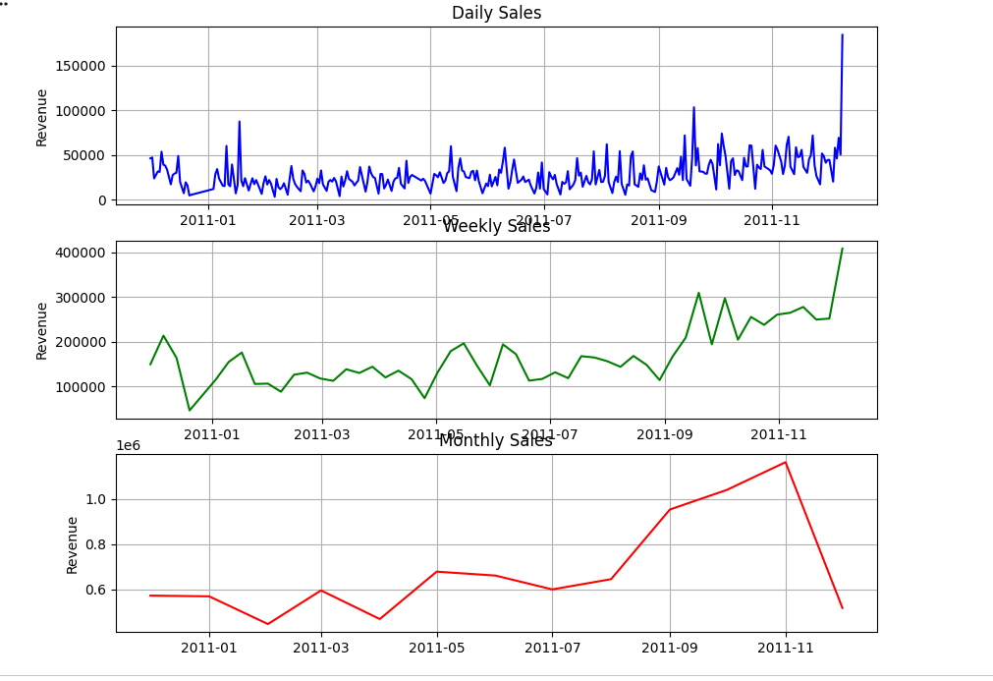
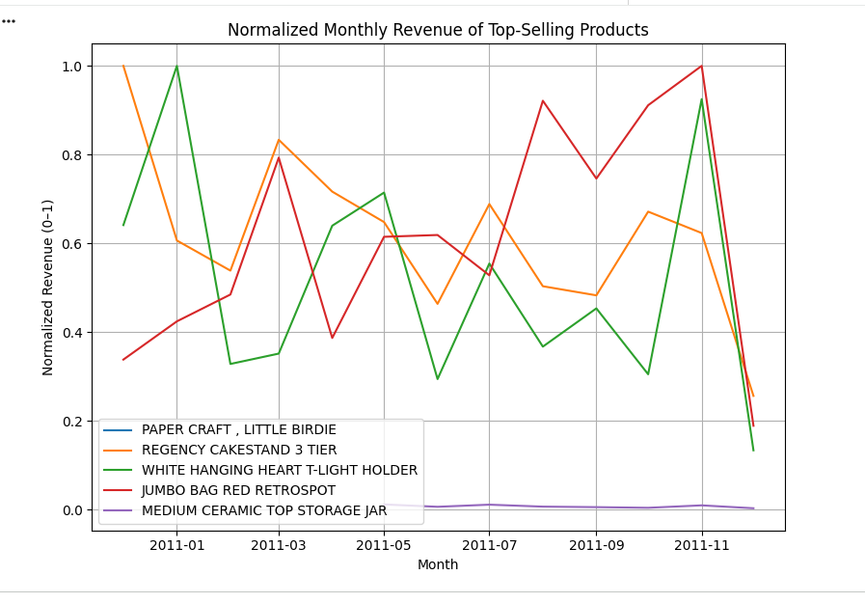
Exploratory Data Analysis
Time Series Analysis

Slide 9
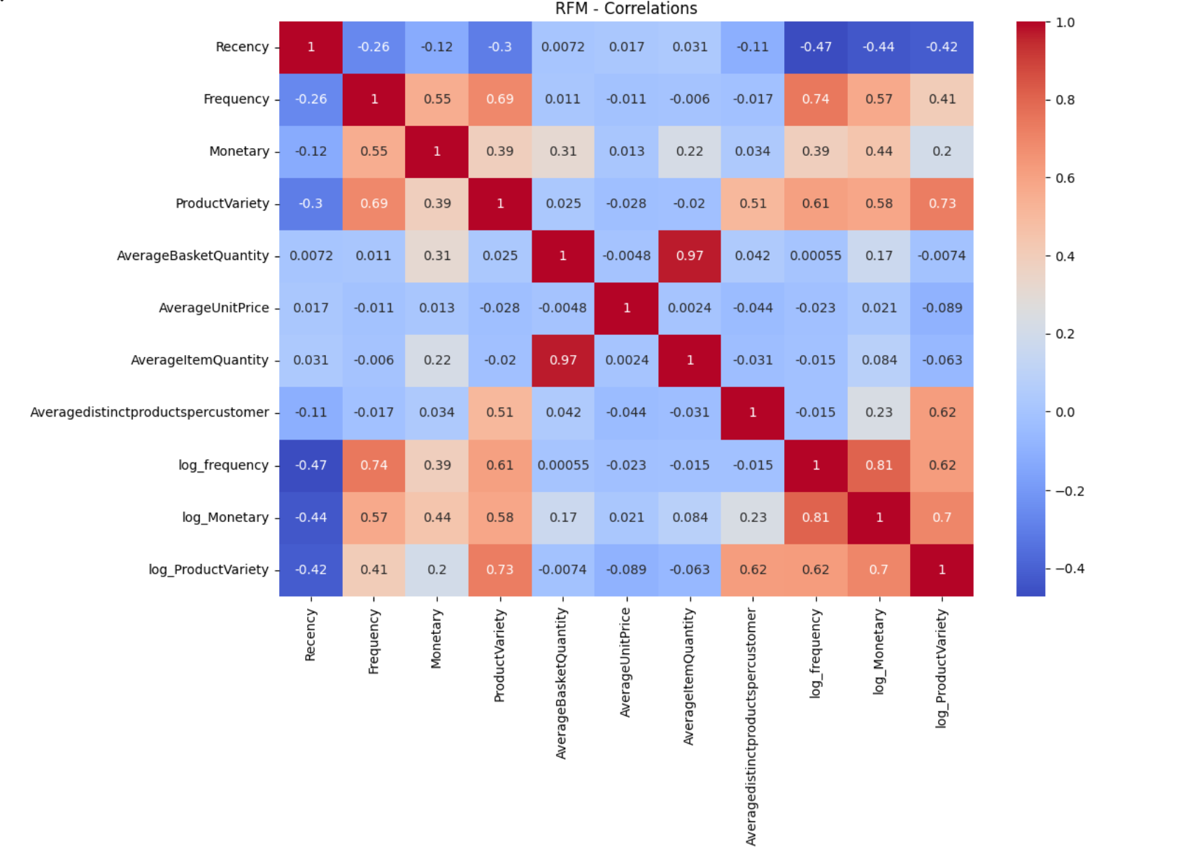
Feature Engineering
RFM
Recency Frequency and Monetary dataframe creation to prioritize marketing strategies.
Adding columns to RFM dataframe to improve clustering

Slide 10
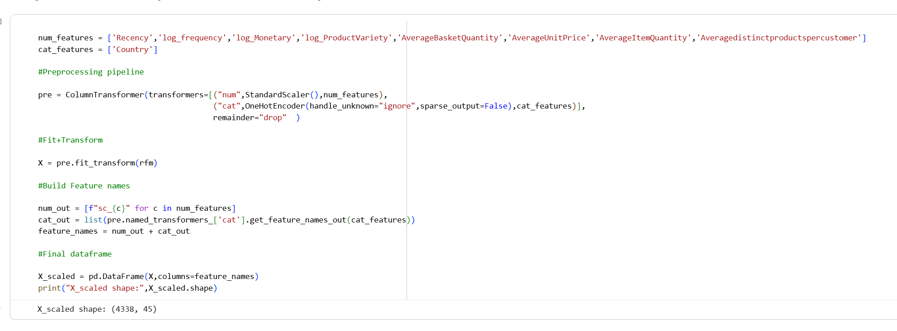
Feature Scaling
Preprocessing Stage 2
Recency Frequency and Monetary dataframe creation to prioritize marketing strategies.
Adding columns to RFM dataframe to improve clustering

Slide 11
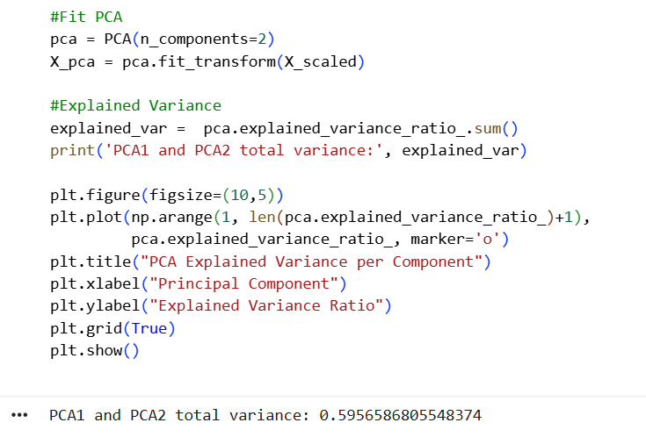
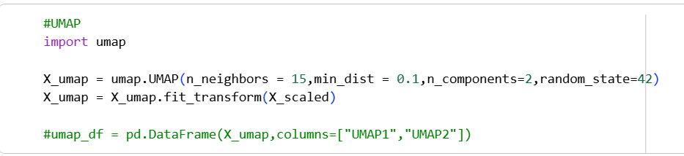
Unsupervised Learning Techniques
Dimensionality Reduction - PCA and UMAP
Recency Frequency and Monetary dataframe creation to prioritize marketing strategies.
Adding columns to RFM dataframe to improve clustering

Slide 12
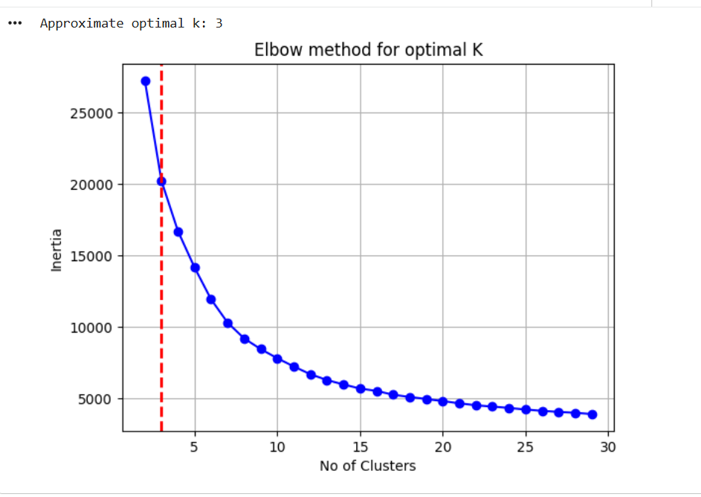
Unsupervised Learning Techniques
K-Means Clustering Algorithm
Analysis:
k value found using:
Elbow Method (k=3)
Silhouette Score (for k=3 , score = 0.32142239788983323)
DB Score (for k=4 , according to the plot above )

Slide 13
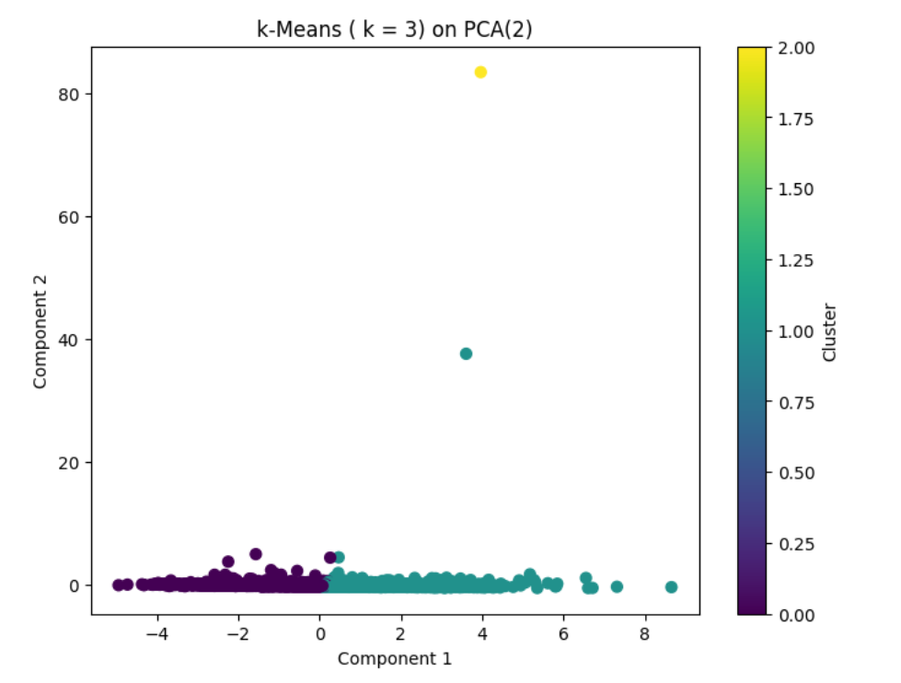
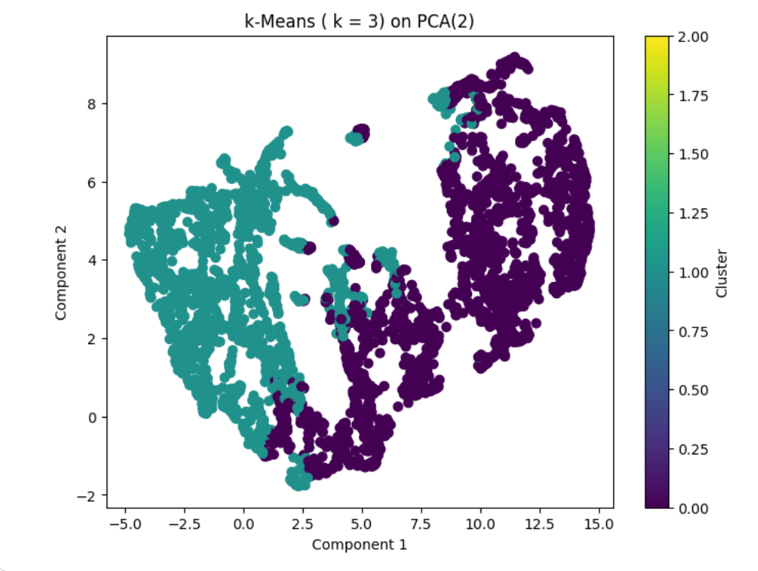
Unsupervised Learning Techniques
K-Means Visualization with PCA and UMAP
Place Value and Number Sense
Operations with Whole Numbers
Fractions and Decimals
Geometry
Measurement and Data
Addition
Ratios and Proportions
Algebraic Concepts
Word Problems
Problem Solving
Subtraction
Multiplication

Slide 14
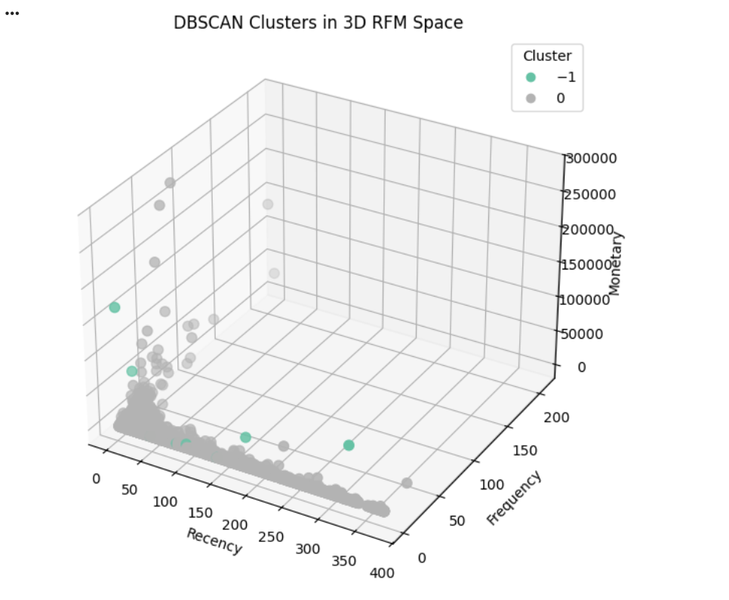
Unsupervised Learning Techniques
DBSCAN
In DBSCAN Clustering results,outliers are the data points labelled as -1.
These are the customers whose RFM behavior doesn't fit into any of the dense clusters DBSCAN identified.
We can see that only outliers and 1 cluster is formed and that is the reason why Silhouette score is very high.
This means that DBSCAN didn't predict useful customer segments and only a dense group is formed.

Slide 15
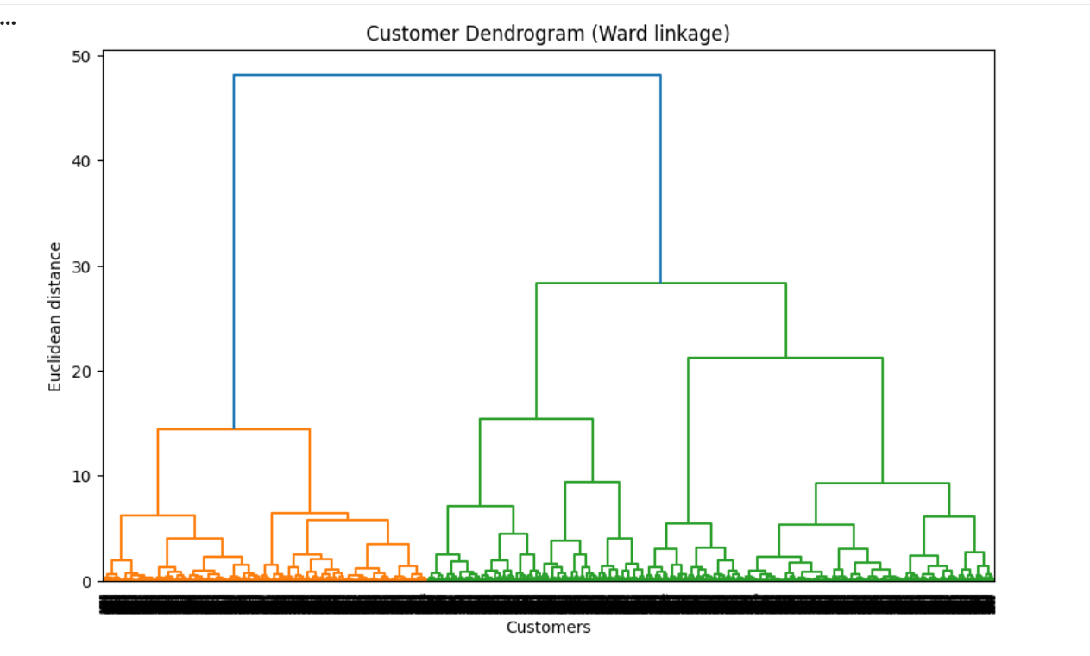
Unsupervised Learning Techniques
Hierarchical Clustering - Agglomerative
Based on the visual selection of this denodram,the most significant groupings are
3-Cluster Selection
4-Cluster Selection
2 -Cluster selection
According to Silhouette score, k=2/3 can be chosen.

Slide 16
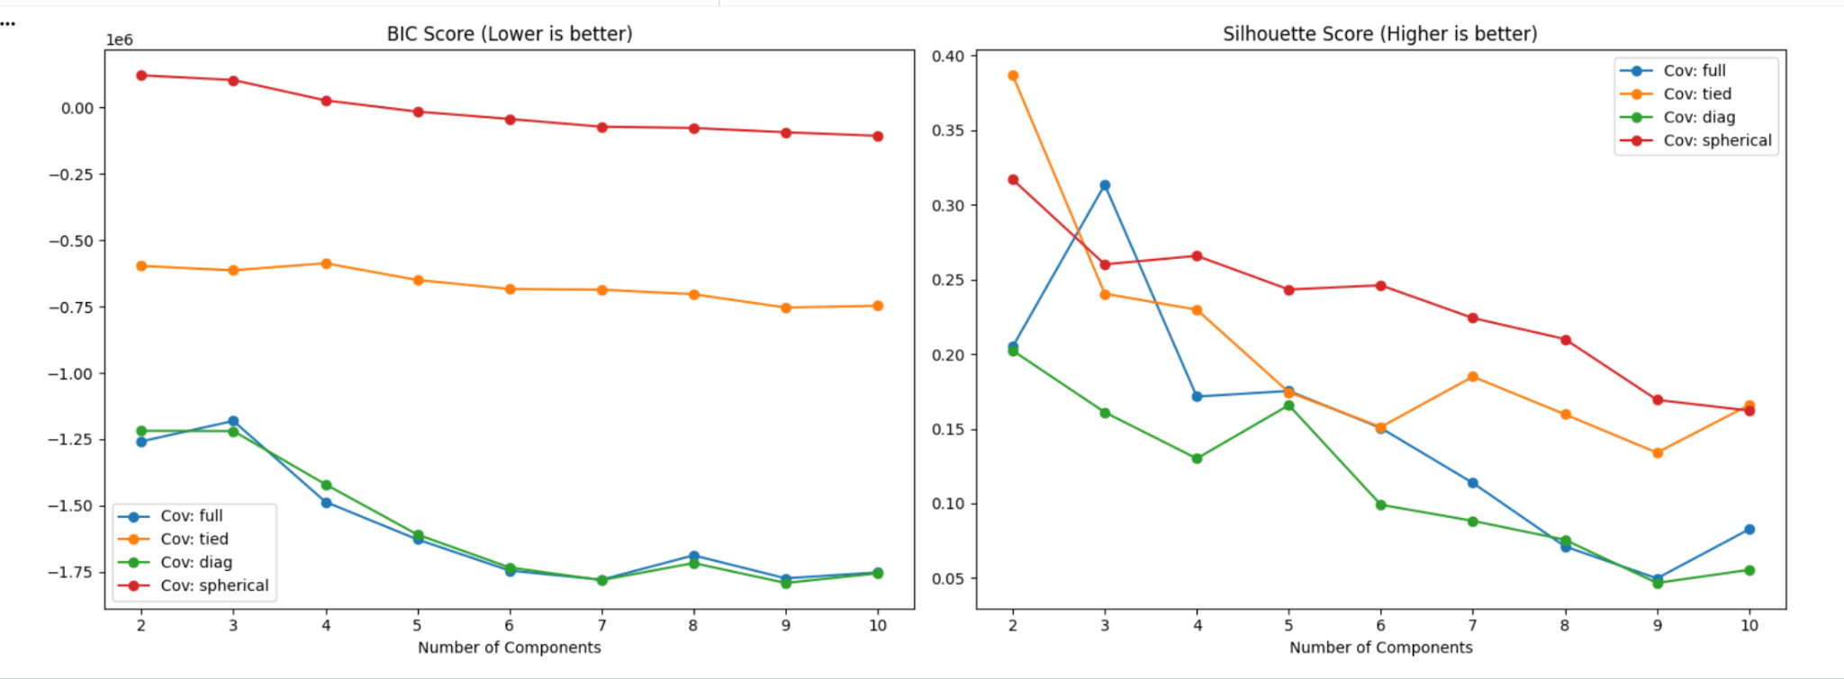
Unsupervised Learning Techniques
GMM Clustering

Slide 17
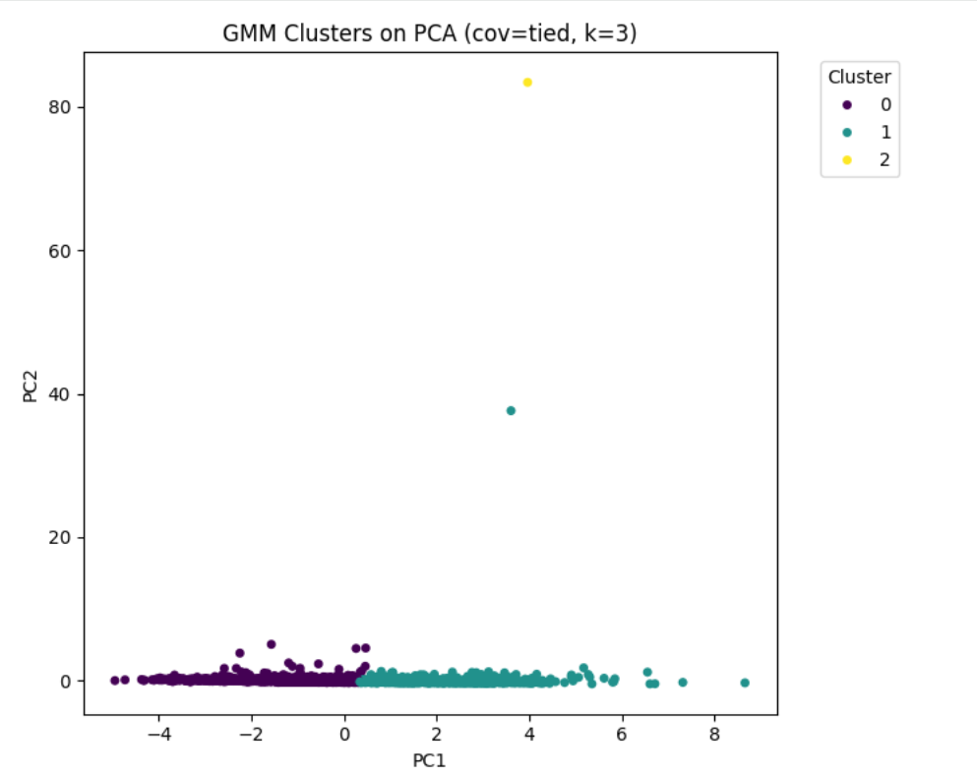
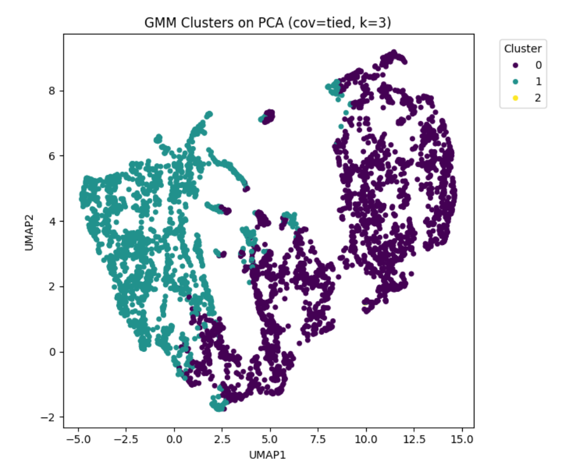
Unsupervised Learning Techniques
GMM Visualization on PCA and UMAP

Slide 18
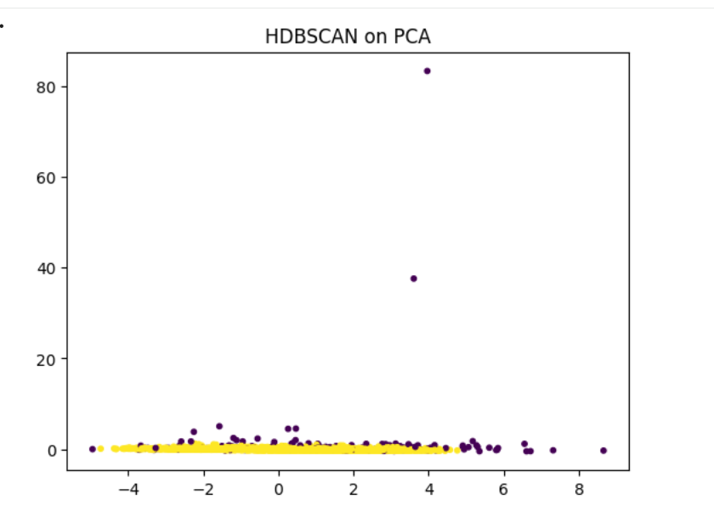
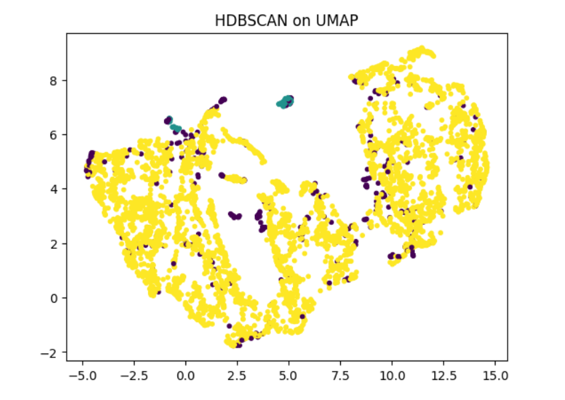
Unsupervised Learning Techniques
HDBSCAN

Slide 19
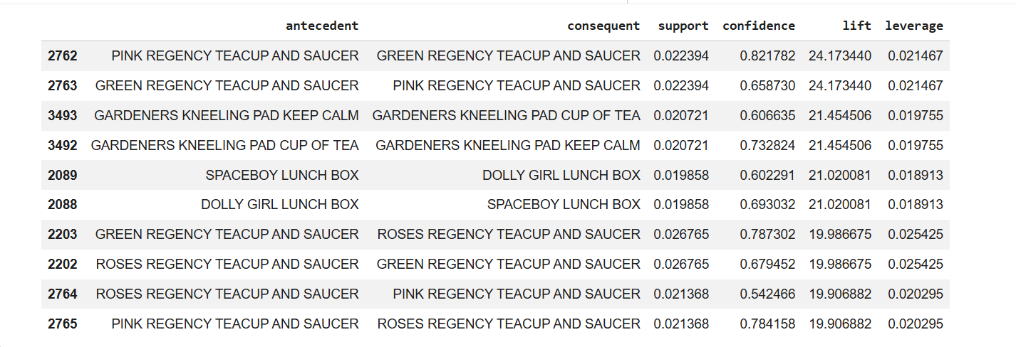
Unsupervised Learning Techniques
Market Basket Analysis

Slide 20
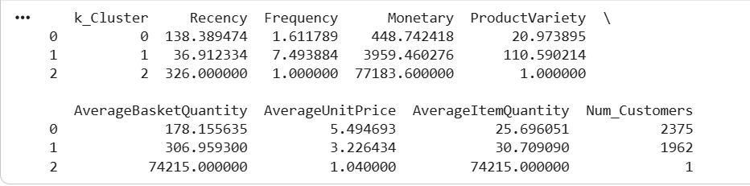
Conclusion
Analysis
Cluster 0: At Risk/Inactive Customers
Cluster 1: Champion/Loyal Customers
Cluster 2: Outliers

Slide 21
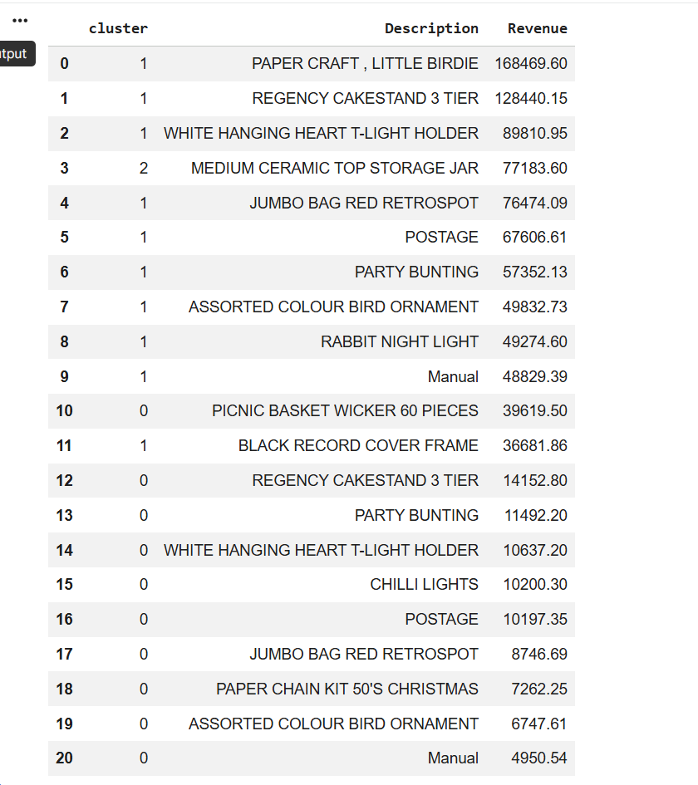
Conclusion
Analysis
Cluster 0: Decor Items
Cluster 1: Seasonal Stuff
Cluster 2: Outliers

Slide 22
Things to Improve
Feature engineering enhancements can be done by adding time based features.
Create Pairwise ratios like (Monetary/Frequency) etc.
Dimensionality reduction techniques like t-SNE can be used.They are good for visualizing small datasets with complex structure.
NMF can be done.
Evaluation scores like Davies-Bouldin and Calinski-Harabasz score can be calculated.

Slide 23
References
https://medium.com/@hasan.unlu/online-retail-clustering-3bbf860e249b
https://medium.com/@hasan.unlu/online-retail-clustering-3bbf860e249b
https://towardsdatascience.com/market-basket-analysis-with-pandas-246fb8ee10a5/
https://www.geeksforgeeks.org/machine-learning/hdbscan/
https://www.geeksforgeeks.org/data-analysis/principal-component-analysis-pca/
https://www.geeksforgeeks.org/machine-learning/hierarchical-clustering/

Slide 24
Links
The deliverables for Unsupervised Learning project can be found below:
Video Link :
https://youtu.be/w5QH4oOOW_U
GitHub Repository:
https://github.com/kmadhu181090/MS-AI/tree/main/Pathway%20Machine%20Learning%3A%20Theory%20%26%20Hands-On%20Practice%20with%20Python%20Specialization/CSCA%205632%3A%20Unsupervised%20Algorithms%20in%20Machine%20Learning

Slide 25
Thank You

